Slide 1
How to add a user in WDesk
Administrator Access
Jo-Anne Aguilar
March 25, 2020

Slide 2
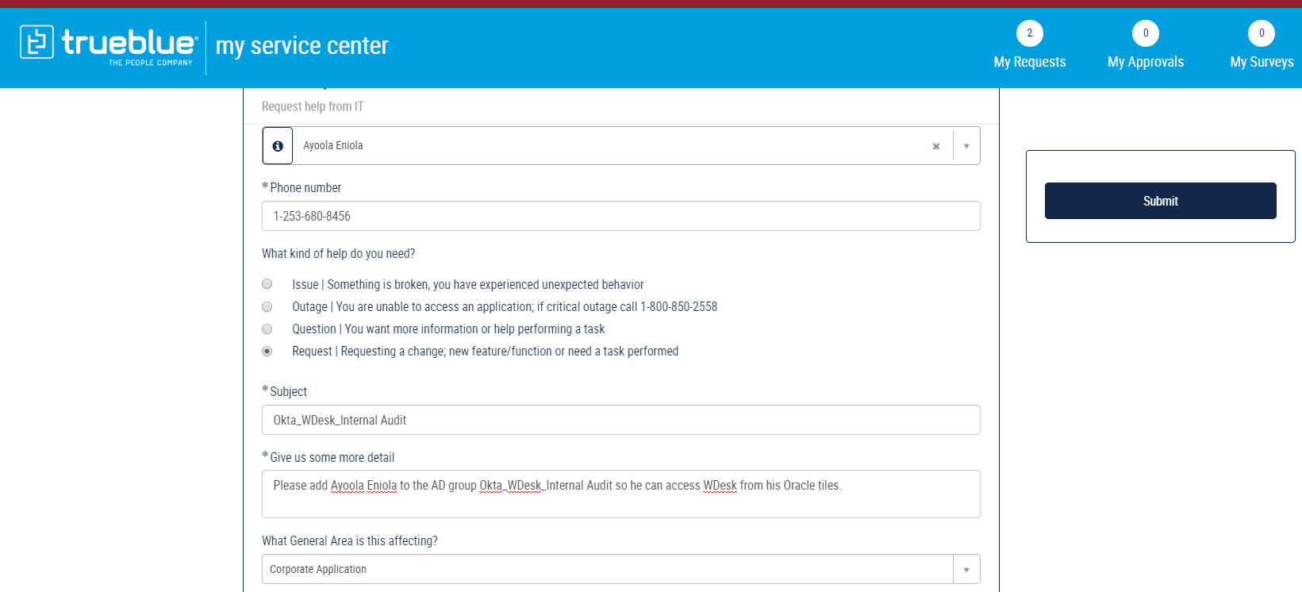
Step 1: Initiate a new request to add new user to the AD group "Okta_WDesk_Internal Audit“ and Okta_WDesk_External Reporting” through Service Now.

Slide 3
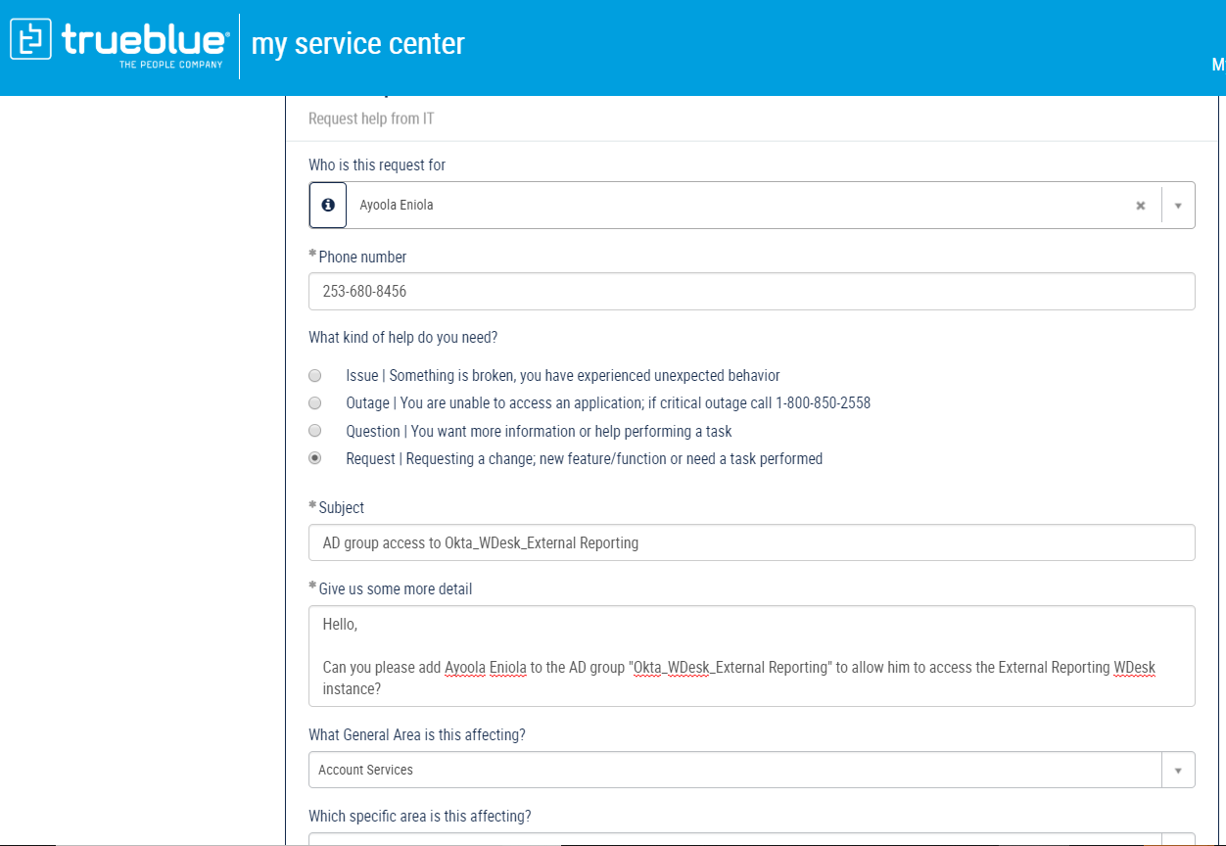
Step 2: Initiate a new request to add new user to the AD group "Okta_WDesk_Internal Audit“ and “Okta_WDesk_External Reporting” through Service Now. (You may also create just one service ticket for steps 1 and 2).

Slide 4
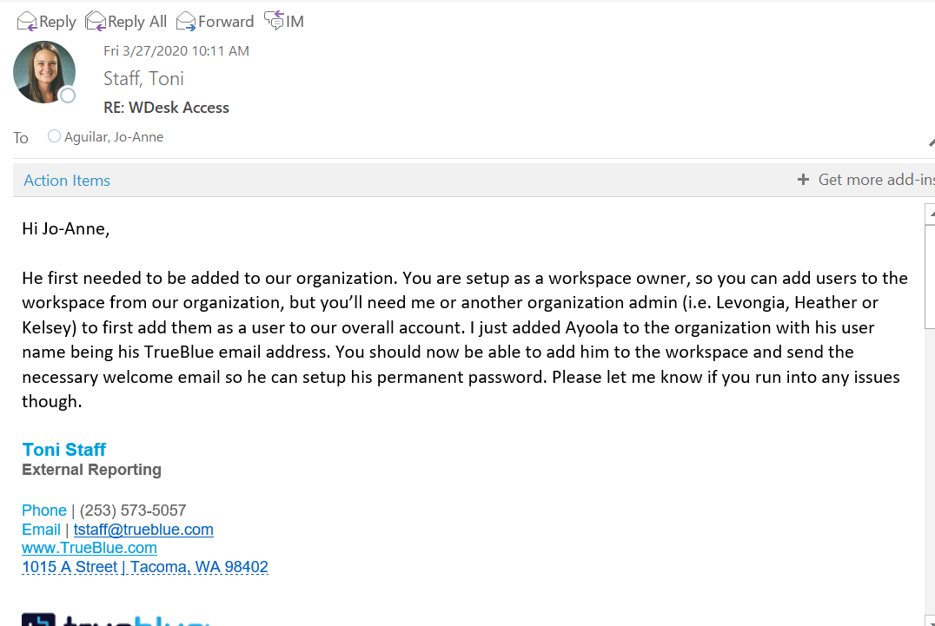
Step 3: Send an email request to one of the WDesk External Reporting organization admins (such as Toni Staff/Levongia Carrera/ Heather/Kelsey Pereboom) to add the user to the External Reporting organization.

Slide 5
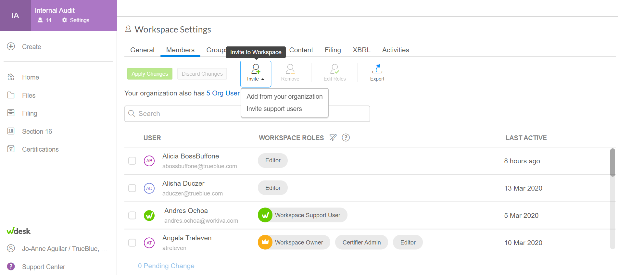
Step 4: Once the user has been added into the WDesk External Reporting organization, log into WDesk and click “Invite” under the Workspace Settings.

Slide 6
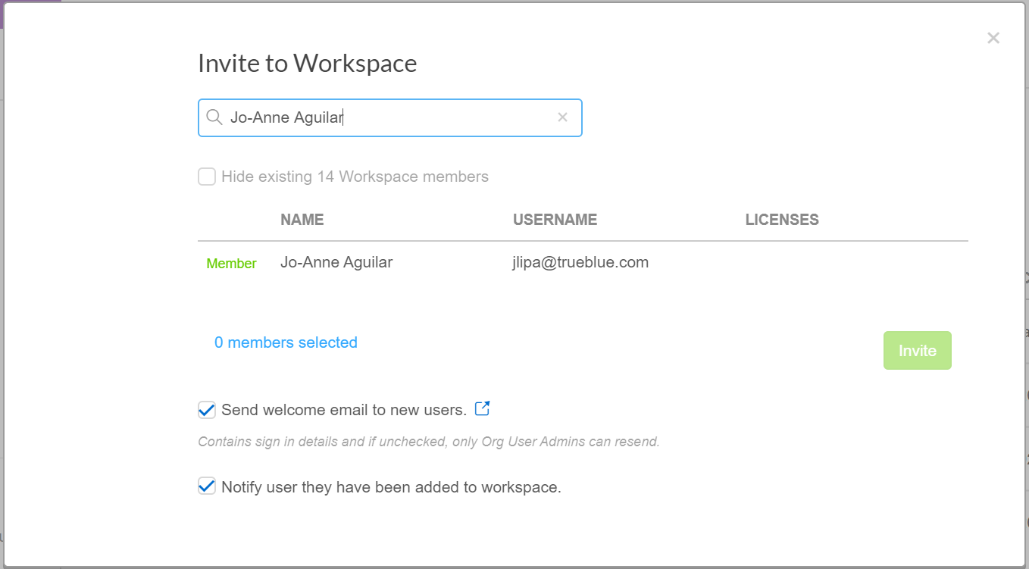
Step 5: Enter the user’s name in the search field and click invite. Confirm that the user received an email invite and link to WDesk. --- End of step ---

